Slide 1


Slide 2


OUTLINE
01.
Project Overview
02.
Technical Feasibility
03.
Economic Feasibility
04.
Operational Feasibility
05.
Conclusion
Page 6
Page 2
Notes:
Illustration:
https://www.freepik.com/free-vector/cartoon-characters-coworking-center-creative-space-freelancers-designers-work-together_3266662.htm

Slide 3


sheSecure
Project Overview
A women safety app with the aim to increase safety and security to women of all age and for empowering women by using technology as a social tool
Page 3
Notes:
Illustration:
- https://www.freepik.com/free-vector/couple-riding-supermarket-shopping-cart_2238492.htm

Slide 4

sheSecure
Key Features
01.
Emergency Alert System
Virtual Companion
02.
Safe Route Planner
03.
Page 4
Notes:
Illustration :
https://www.freepik.com/free-vector/teamwork-characters-operator-crew-front-screen-presentations_4997765.htm

Slide 5

sheSecure
Key Features
04.
High Danger Area Alert
Daily Notifications
05.
Self Defense Tutorial
06.
Page 5
Notes:
Illustration :
https://www.freepik.com/free-vector/teamwork-characters-operator-crew-front-screen-presentations_4997765.htm

Slide 6










sheSecure
Java
Technical Feasibility
Software and Hardware Requirements for sheSecure
Java
MongoDB / JDBC
Android Studio Postman
Frontend
Development
Collaboration
Tool
Development
Tool
Database
Management
Backend
Development
Client side of Android studio
APIs like Twilio, Google Map
Page 6
Notes:
Illustration:
- https://www.freepik.com/free-vector/couple-riding-supermarket-shopping-cart_2238492.htm

Slide 7
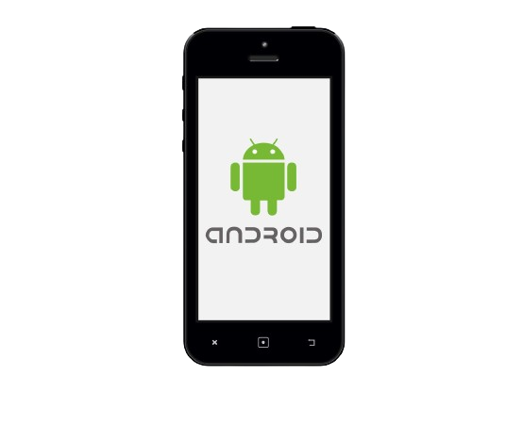

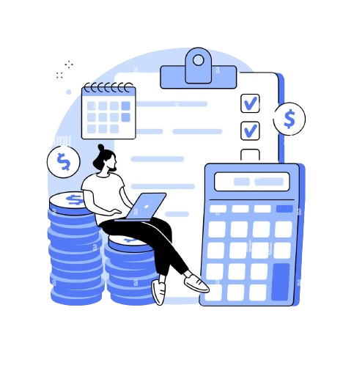
sheSecure
Technical Feasibility
Infrastructure Constrains
Minimum Internet requirement
Well-equipped Mobile
Consideration of budget constraints
Page 7
Notes:
Illustration:
- https://www.freepik.com/free-vector/couple-riding-supermarket-shopping-cart_2238492.htm

Slide 8





sheSecure
Technical Feasibility
Complexity and Risks
Maintaining Real time Information for the map
Updating and scrutinizing
emergency information
and speed dials regularly
Offline data storing may be vital for storing the information of the user
User Information Security is crucial,
may cause significant harm and compromise the trust users place
Page 8
Notes:
Illustration:
- https://www.freepik.com/free-vector/couple-riding-supermarket-shopping-cart_2238492.htm

Slide 9
sheSecure
Operational Feasibility
Improvements expected from sheSecure
Enhanced Safety Communication
Introducing a community forum for sharing safety tips and support, fostering collaboration among users that is not available in any safety apps in our region.
Real-time emergency assistance
Location based safety features
Incorporating location tracking and safe route planning for informed decision-making, empowering women to navigate safely.
Page 9
Notes:
Illustration:
- https://www.freepik.com/free-vector/couple-riding-supermarket-shopping-cart_2238492.htm

Slide 10
sheSecure
Operational Feasibility
Ensuring Adequate Throughput and Response
Cloud Infrastructure Comparison
platforms like Noonlight and beSafe, with dedicated server infrastructure, offer higher throughput and faster response times that sheSecure is trying to match .
Optimization & User Experience
Despite challenges, SheSecure prioritizes critical features, optimizes network requests, and minimizes latency.
Monitoring and Scaling
Regardless of infrastructure differences, SheSecure maintains reliability.
Page 10
Notes:
Illustration:
- https://www.freepik.com/free-vector/couple-riding-supermarket-shopping-cart_2238492.htm

Slide 11
sheSecure
Operational Feasibility
Facilitating Information Accessibility & User Friendly Interaction
Wide Applicability and User Engagement
Swift Data Exchange
Swift Data Exchange
Synchronized Safety Feature
Synchronized Safety Feature
Intuitive User Interface
Intuitive User Interface
Wide Accessibility
Wide Accessibility
Ensuring relevance and accuracy
Ensuring relevance and accuracy
Strategic Marketing
Strategic Marketing
Page 11
Notes:
Illustration:
- https://www.freepik.com/free-vector/couple-riding-supermarket-shopping-cart_2238492.htm

Slide 12
Economic Feasibility
Tangible Costs
Category | Estimated cost
Development Cost
Coding, Design and Testing | Free
Hosting & Server Cost | 10,000-20,000/month
Maintenance & Update | 5,000-10,000/month
Integration & Compatibility | Yet to be analyzed
Global Economic Factors | 20,000-50,000/year
Page 12
Notes:
Illustration :
https://www.freepik.com/free-vector/teamwork-characters-operator-crew-front-screen-presentations_4997765.htm

Slide 13


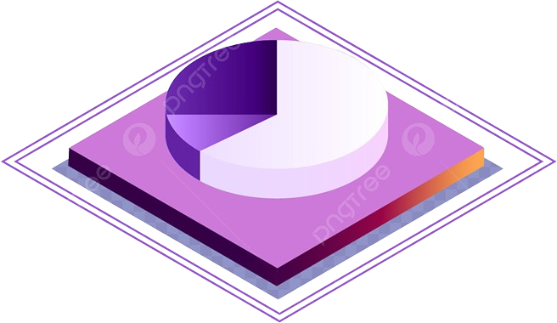


Economic Feasibility
Intangible Costs
Marketing
And Promotion
Analyses Models
Market Research and Analysis
Scalability Considerations
Page 13
Notes:
Illustration :
https://www.freepik.com/free-vector/teamwork-characters-operator-crew-front-screen-presentations_4997765.htm

Slide 14
sheSecure
Operational Feasibility
Tangible Benefits
Intangible Benefits
Swift Data Exchange
Immediate Assistance
Empowerment
Synchronized Safety Feature
Intuitive User Interface
Real-Time Alerts
Wide Accessibility
Community Support
Ensuring relevance and accuracy
Safe Route planning
Strategic Marketing
Awareness and Social Impact
Page 14
Notes:
Illustration:
- https://www.freepik.com/free-vector/couple-riding-supermarket-shopping-cart_2238492.htm

Slide 15
ROI Analysis
Advertisements:
Sponsorships:
Expected monthly revenue: 5000
Monthly growth rate: 5%
Expected monthly revenue: 4000​
Monthly growth rate: 3%
Year | Revenue(Approx.) | Expenses | Annual Profit Loss | Cumulative Profit/Loss
1 | 2,00,000-2,15,000 | 5,85,000-6,00,000 | -3,85,000 | -3,85,000
2 | 2,25,000-2,40,000 | 85,0000-1,00,000 | 1,40,000 | -2,45,000
3 | 2,55,000-2,70,000 | 85,0000-1,00,000 | 1,70,000 | -75,000
4 | 2,85,000-3,00,000 | 85,0000-1,00,000 | 2,10,000 | 1,35,000
Page 15
Notes:
Illustration :
https://www.freepik.com/free-vector/teamwork-characters-operator-crew-front-screen-presentations_4997765.htm

Slide 16
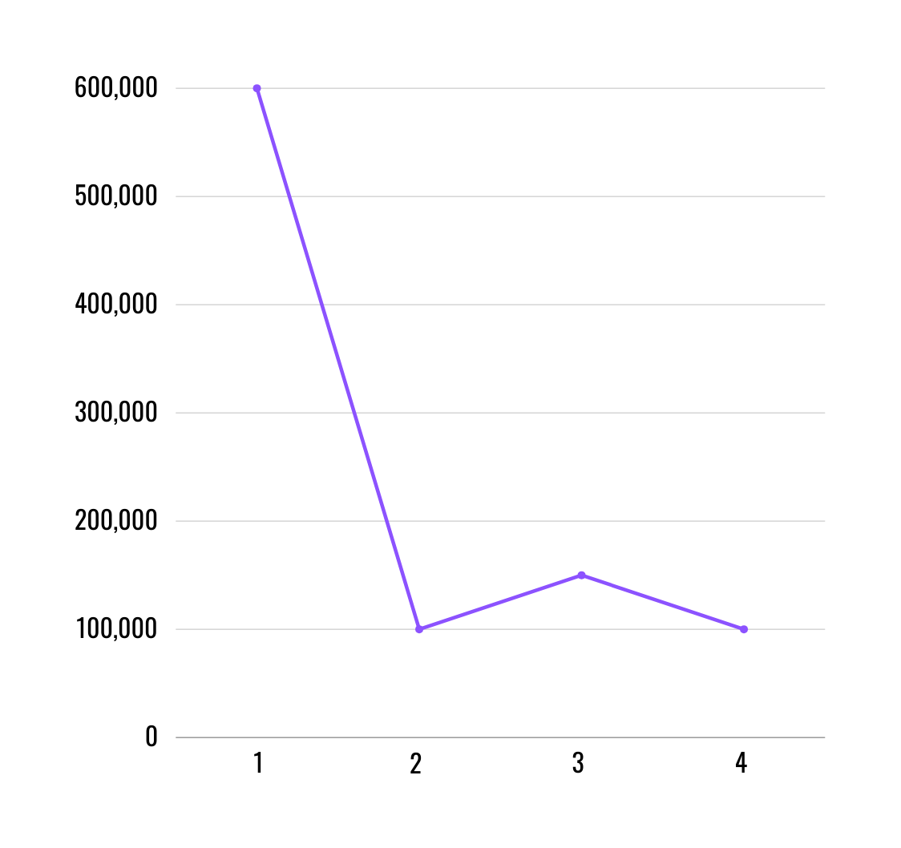
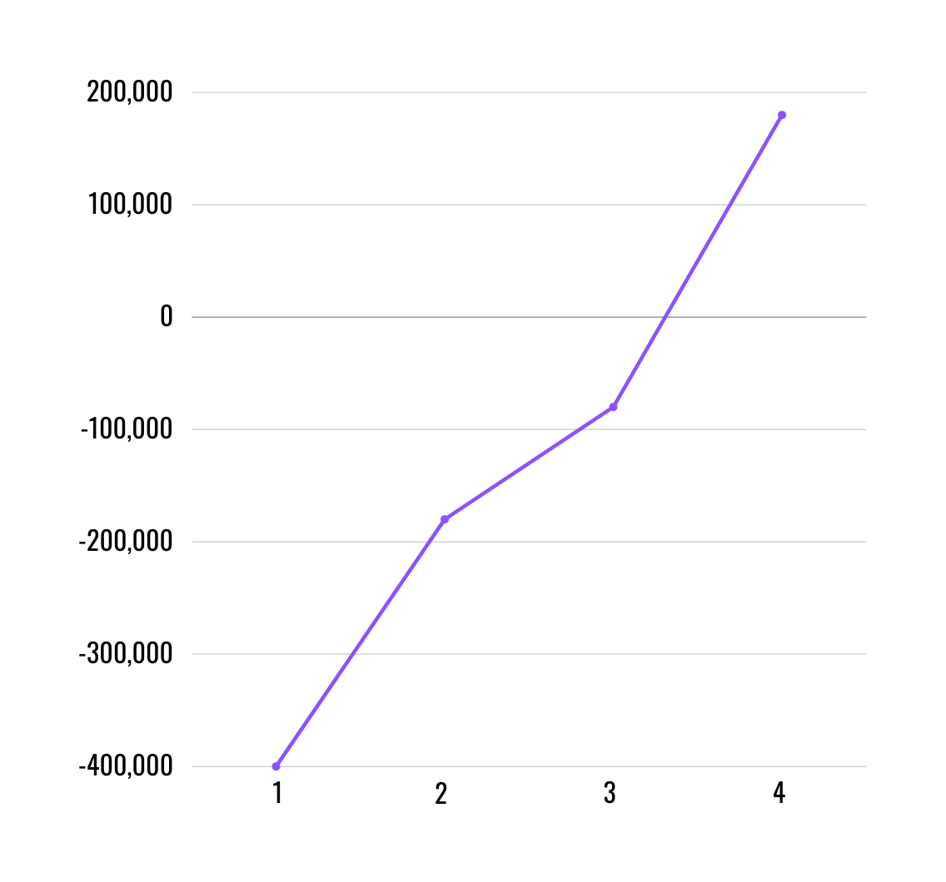
Break-Even Analysis
Expected break-even point to be reached before the beginning of the fourth year
Expenses over year
Expected Revenue over year
Page 16
Notes:
Illustration :
https://www.freepik.com/free-vector/teamwork-characters-operator-crew-front-screen-presentations_4997765.htm

Slide 17

Team
KICHU EKTA BANABO
FATEEN NOOR RAFEE
21004120
RIHILA SUMAYYA
NOWSHIN MAHJABIN
210041110
21004128
Page 17
Notes:
Illustration :
https://www.freepik.com/free-vector/teamwork-characters-operator-crew-front-screen-presentations_4997765.htm

Slide 18

Thank You!
Notes:
Illustration:
- https://www.freepik.com/free-vector/couple-riding-supermarket-shopping-cart_2238492.htm

